Slide 1

Malware Classification through Computer Vision
Prasann Viswanathan Iyer
190070047

Slide 2
Introduction
Static Malware classification - without executing the programme
Signature matching - Standard Method but with limitations
Obfuscations in code
Exponentially growing number of signatures
Machine Learning Approaches are more robust and scalable
Feature Construction issues
Disassembly step
Binning the types of function calls, counting loops
Large Feature space requires reduction with PCA or K-PCA
Aim is to consider Malware Classification as a Computer Vision problem

Slide 3
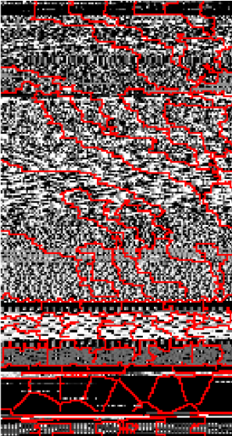
Methodology
Convert Byte Code of Malware to images
Map Binary Code to integers in [0,255]
Convert to 2D image with dimensions based on size of Malware file
Apply Transfer Learning via existing Deep Image Neural Networks
Inception
ResNet
VGG
DenseNet
Classic feature construction method and image method to Decision Forest
Compare the classification performance

Slide 4
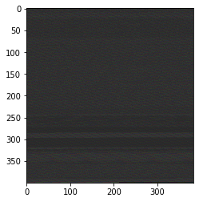
.bytes File to .png Conversion
.bytes file contains byte-wise representation of the malware .asm code
Each byte represents a number from 0 to 255
To construct the R channel of the image we take bytes indexed 0 mod 3
To construct the G channel of the image we take bytes indexed 1 mod 3
To construct the B channel of the image we take bytes indexed 2 mod 3
Next we resize the 1D R,G,B arrays to 2D with height and width ∝ file size
My dataset consists of 4307 .bytes files with sizes from 1Kb to 10Kb

Slide 5
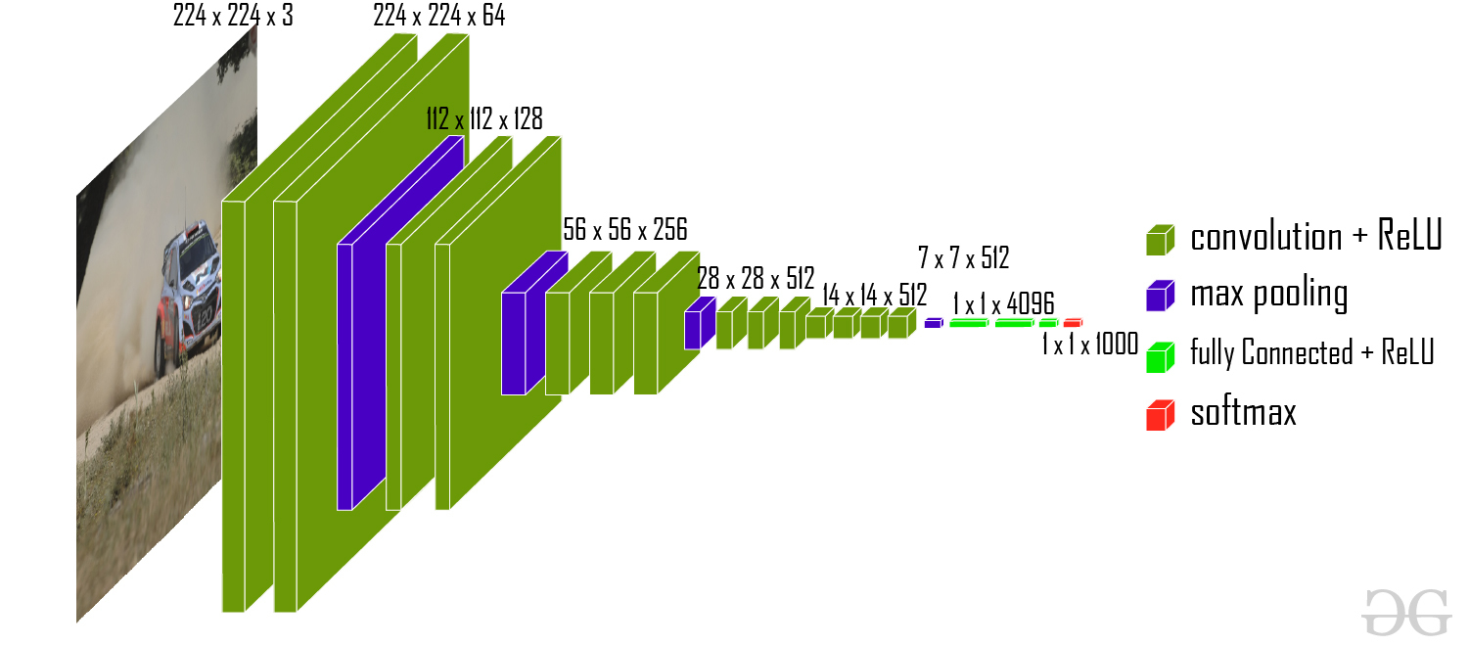
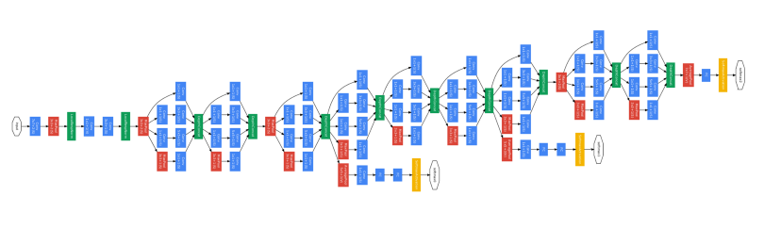
Transfer Learning Models Used
Inception Network
global average pooling layers
dense layer with 512 nodes ReLu activation
output dense layer with 9 nodes with softmax activation
VGG16 Network
flattened VGG16 model with 14 million fixed weights
2 dense layer with 512 nodes ReLu activation
output dense layer with 9 nodes with softmax activation

Slide 6
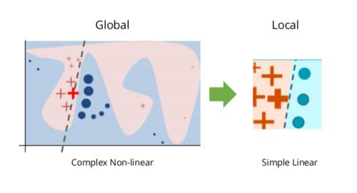
Evaluation and Interpretation
Classification Metrics
Accuracy
True Positive Rate
False Positive Rate
F1 score
Local Interpretable Model-Agnostic explanation algorithm
To understand the reason for our models prediction
Conclude whether conversion to images assists in Malware Classification
With respect to both Classification Metrics and Model Performance Speed

Slide 7
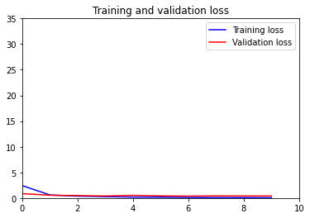
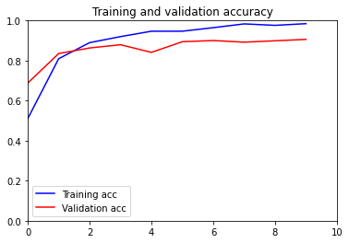
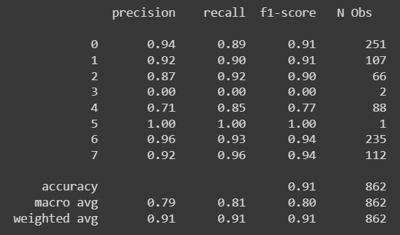
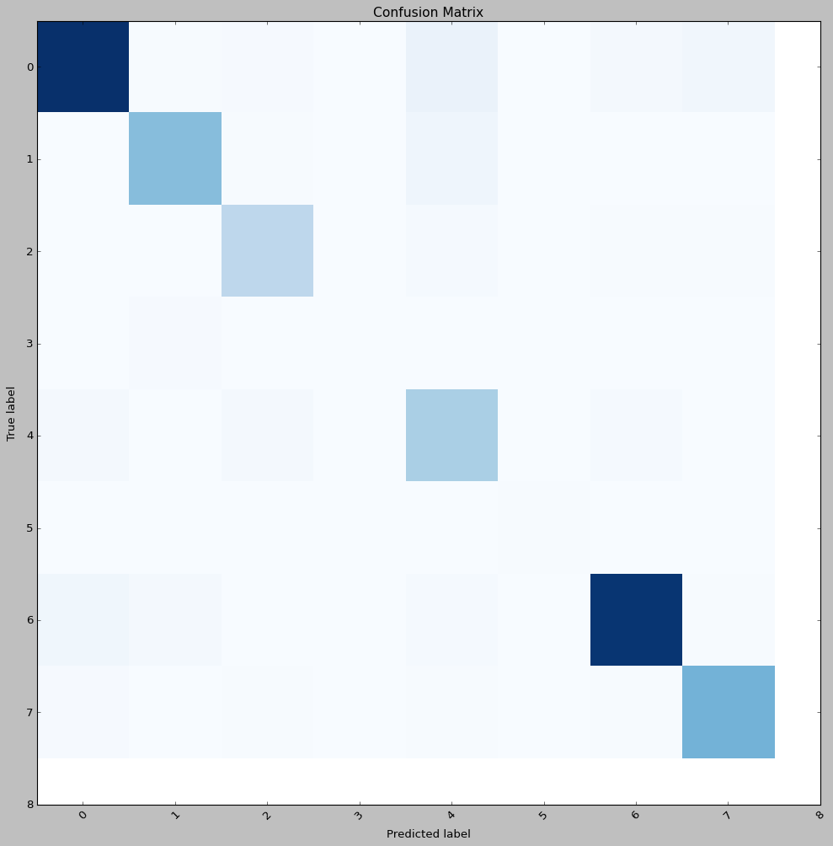
Model Performance
Accuracy - (98.46% on Training and 90.6% on Test)
Loss - (0.0555 on Training and 0.3987 on Test)
Precision - 0.91
Recall - 0.91
F1-Score - 0.91

Slide 8
Future Work Directions and Conclusion
Additional topics not done primarily due to lack of computing abilities
Training a model from scratch instead of transfer learning (article)
benign file or a harmful file rather than according to their family
Unavailability of a suitable dataset for this
I could improve performance if I knew which layers to include in the VGG16 model to prevent overfitting to some degree
Super Pixel Validation technique
Being able to perform so well on RGB photos of malware byte code with only a little fine tweaking is amazing considering that the majority of these models were trained on photographs of dogs, cats, and other pets.

Slide 9
Thank You

